Slide 1
Box Model & Intro to Layout
Week 4

Slide 2
Box Model
Notes:
This lecture, we’re going to be talking about something super important to CSS: the CSS Box Model! The CSS Box Model is so important that many web developers get asked about this all the time during interviews.
So what’s the CSS Box Model?
The CSS Box Model is a mental model for how we think about the size of boxes in CSS. Let’s break that down.
First, what are boxes?
Boxes simply refer to any HTML tag (we also call these “elements”) that can be thought of as rectangles, with a width and a height (like a box). This is actually most HTML elements, like <section>, <div>, <h1>, <h2>, and <p>. There are a few that aren’t boxes, but we’ll get to those later.
Next, what do we mean by the “size of boxes in CSS”?
When we control the size of box elements in our CSS code, we use the “width” and “height” properties in CSS. But it turns out, sometimes we want “width: 100px” to mean different things.
For example, sometimes we want our width to include some borders, and sometimes we want our width declaration to just include the content, widthout counting the thickness of the borders or margins. The Box Model is a way to think about these different situations. Let’s dive in.

Slide 3
What's inside/outside a box?

Slide 4
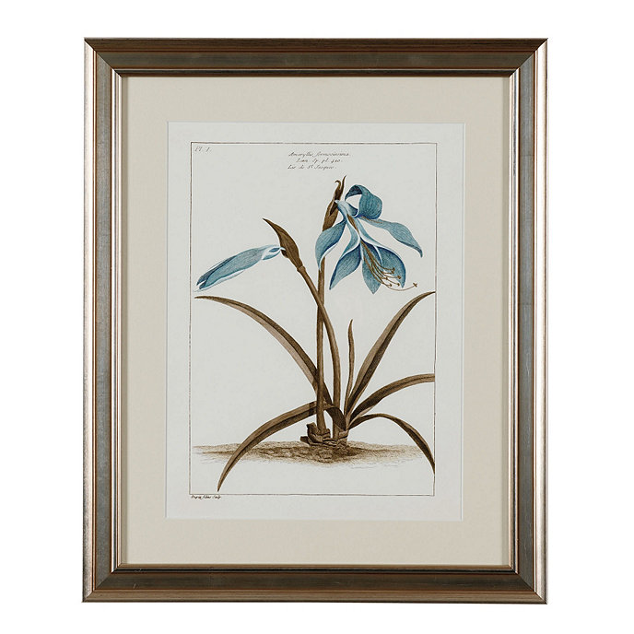
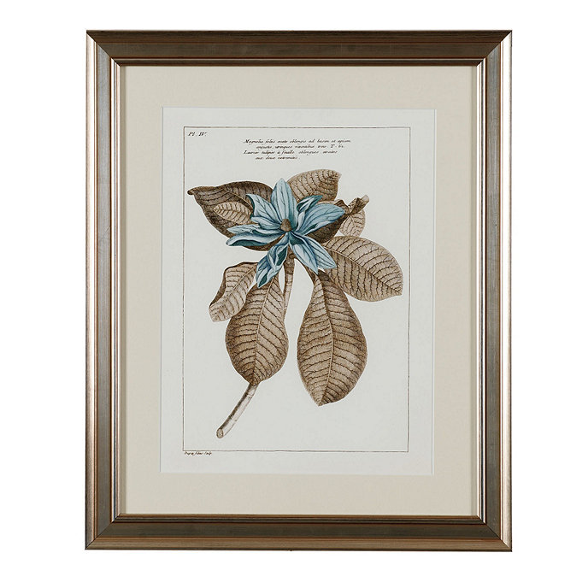
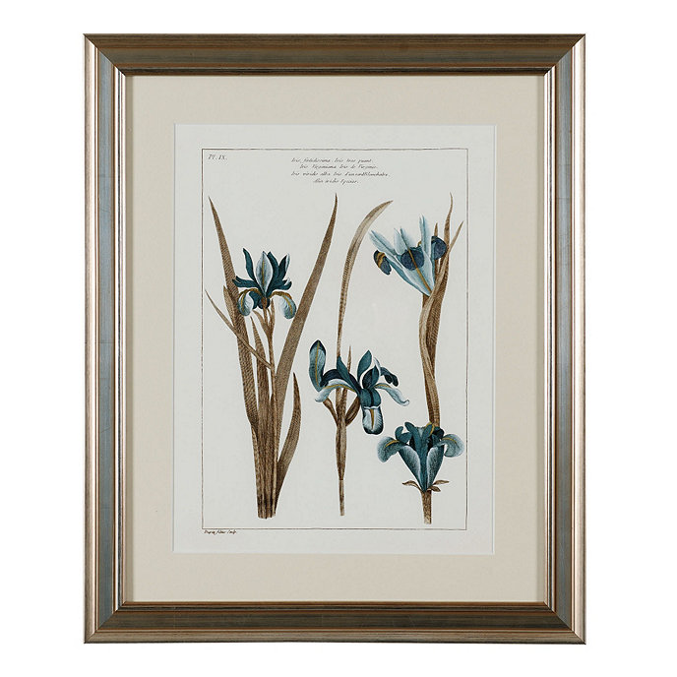
Picture frame analogy
Notes:
We’re going to use these picture frames as an analogy!

Slide 5
margin
border
padding
content
padding
border
Picture frame analogy
Notes:
In these frames, there are four different parts in each frame:
The content, which is the thing that’s inside the boxes. It’s the thing that the boxes exist to show. In this case, it’s the beautiful pictures inside the frames.
The padding, which is the bit of whitespace that evenly surrounds the content. The padding is sometimes zero (not there), but padding between the edges of boxes and the content is nice to have, because it gives our content some breathing room.
The border, which is pretty self-explanatory. It’s the actual frame in the picture -- the line that delineates the inside and outside of the boxes.
The margin, which is the whitespace that lies outside of the border, and that separates the boxes from other stuff around it, giving the whole box some breathing room around it.
The Box Model refers to the order in which these four layers are composed, when we talk about box elements in CSS.

Slide 6
content
The picture itself
Picture frame analogy
Notes:
(from previous slide)
The content, which is the thing that’s inside the boxes. It’s the thing that the boxes exist to show. In this case, it’s the beautiful pictures inside the frames.

Slide 7
padding
Space between the picture and the picture frame
Picture frame analogy
Notes:
(from previous slide)
The padding, which is the bit of whitespace that evenly surrounds the content. The padding is sometimes zero (not there), but padding between the edges of boxes and the content is nice to have, because it gives our content some breathing room.

Slide 8
border
The picture frame
Picture frame analogy
Notes:
(from previous slide)
The border, which is pretty self-explanatory. It’s the actual frame in the picture -- the line that delineates the inside and outside of the boxes.

Slide 9
margin
Spacing in between pictures
Picture frame analogy
Notes:
(from previous slide)
The margin, which is the whitespace that lies outside of the border, and that separates the boxes from other stuff around it, giving the whole box some breathing room around it.

Slide 10
margin
border
padding
content
padding
border
Picture frame analogy, all highlighted

Slide 11
margin
border
padding
content
padding
border
Picture frame analogy, now without the picture frame :o
Notes:
Here’s what the Box Model looks like without the analogy. This is exactly how CSS thinks about boxes.

Slide 12
Box model
margin
border
content
The picture itself
padding
Space between the picture and the picture frame
border
The picture frame
margin
Spacing in between pictures
padding
content
padding
border
margin

Slide 13
Defining boxes
margin
border
content-box
The box that contains the content
padding-box
The box that encloses the content and the padding
border-box
The box that encloses the content, the padding and the border
padding
content
padding
border
margin
Notes:
There’s a few different types of boxes. Depending on which type of box we make an element (we can change the box style using the box-sizing: … property in CSS), we can change what type of a box CSS uses for an element.
Why do we have different types of boxes? These types let us use different definitions of ‘width” and “height”, so they include padding/border or don’t include either, depending on what we need.

Slide 14
What's the width/height of a box when we have… content-box • padding-box • border-box

Slide 15
Width/height can mean different things
#exploding-tomato {
box-sizing: content-box; /* default */
width: 60px;
height: 60px;
padding: 10px;
border: 10px;
}
#imploding-tomato {
box-sizing: border-box;
width: 60px;
height: 60px;
padding: 10px;
border: 10px;
}
60px
60px
Notes:
In the left, when we give the box box-sizing: content-box, our width property just refers to the size of the content. All the rest of the stuff around it just piles on around it, given the content’s size.
In the right, when we give the box box-sizing: border-box, our width property is interpreted as the size of the content, plus the size of padding and border. So CSS does the right calculations and makes sure that, given the thicknesses of padding and border given, the content is small enough that the whole border area becomes the given width.

Slide 16
Order of specifying dimensions
Typically we specify things by going around a clock
top .. right .. bottom .. left
top
left
right
bottom
Notes:
In CSS, when we specify dimensions, we generally go in the order: top, right, bottom, then left.
In other words, when we specify the thicknesses of a box’s border (border-width), we can say:
border-width: 10px 20px 30px 40px
Where 10, 20, 30, and 40 are top, right, bottom, and left widths respectively.

Slide 17
Specifying paddings
#potato {
/* box-sizing: content-box; */
width: 60px;
height: 60px;
padding-top: 10px;
padding-right: 20px;
padding-bottom: 30px;
padding-left: 40px;
/* or more neatly... */
padding: 10px 20px 30px 40px;
}
10px
20px
40px
60px
30px

Slide 18
Specifying borders
#potato {
/* box-sizing: content-box; */
width: 60px;
height: 60px;
border-top-width: 10px;
border-right-width: 20px;
border-bottom-width: 30px;
border-left-width: 40px;
/* or more neatly... */
border-width: 10px 20px 30px 40px;
}
10px
20px
40px
60px
30px

Slide 19
More with borders
#potato {
width: 60px;
height: 60px;
/* Show a solid border, none for no border (default) */
border-style: solid;
/* Say how thick the border should look */
border-width: 20px;
/* Tell a color */
border-color: #ffd966;
}
Notes:
We can do lots of fun things with border styles, using these properties.

Slide 20
Specifying margins
#potato {
/* box-sizing: content-box; */
width: 60px;
height: 60px;
margin-top: 10px;
margin-right: 20px;
margin-bottom: 30px;
margin-left: 40px;
/* or more neatly... */
border-width: 10px 20px 30px 40px;
}
10px
20px
40px
60px
30px

Slide 21
Box Model Practice
https://tinyurl.com/wddboxy

Slide 22
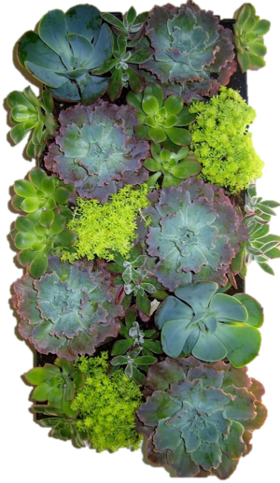
Layout Contexts
How you layout things inside a box
Notes:
Let’s talk about Layout Contexts, where we’ll discover what things don’t quite behave like neat boxes we just discussed.

Slide 23
Block & Inline Formatting Context
There are flex & grid layouts too (for the future)
Notes:
The Block Formatting Context refers to things inside boxes. In other words, it’s everything we’ve just talked about. With block elements (box elements), things behave really neatly -- they stack top to bottom, with clear widths and heights.

Slide 24
We might've bumped into this before…
<h1>Monterey Bay Aquarium</h1>
<strong>Aquarium in Monterey, California</strong><br>
<em>Address: 886 Cannery Row, Monterey, CA 93940</em>
<p>Monterey Bay Aquarium is a nonprofit public aquarium in Monterey, California. Known for its regional focus on the marine habitats of Monterey Bay, it was the first to exhibit a living kelp forest when it opened in October 1984.</p>
Why the <br> ?!
https://codepen.io/sethlu/pen/OqJvwg?editors=1000
Notes:
But there’s another context! To discover this other context, we need to look at tags like <strong> and <em>. When you stack these together one after the other, they appear all in one line, rather than stacked top to bottom like most other elements. In fact, you may have bumped into this situation where you had to use this weird <br> tag to split apart these “inline” elements like <strong> and <em> that sit in one line next to each other.

Slide 25
Why doesn't the text go to a second line??!???!!
Notes:
Good question. Yes. Well...

Slide 26
Why doesn't the text go to a second line
??!???!!
Notes:
Good question. Yes. Well...

Slide 27
One solution… Why does it work?
<h1>Monterey Bay Aquarium</h1>
<strong>Aquarium in Monterey, California</strong><br>
<em>Address: 886 Cannery Row, Monterey, CA 93940</em>
<p>Monterey Bay Aquarium is a nonprofit public aquarium in Monterey, California. Known for its regional focus on the marine habitats of Monterey Bay, it was the first to exhibit a living kelp forest when it opened in October 1984.</p>
<h1>Monterey Bay Aquarium</h1>
<div>
<strong>Aquarium in Monterey, California</strong>
</div>
<div>
<em>Address: 886 Cannery Row, Monterey, CA 93940</em>
</div>
<p>Monterey Bay Aquarium is a nonprofit public aquarium in Monterey, California.
Notes:
One way we can fix it is to wrap each “inline” element with a box (or “block”) element. In this case, we can wrap each <strong> and <em> with their own <div>s, which will make them stack vertically.

Slide 28
Block-level element
Inline-level element
Block-level elements want to take the entire "line" by itself.
Imagine some folks who want all the car back seats by themselves :(
Technical note: It's a block container
Examples:
<div>, <h1>, <h2>, <p>
Inline-level elements are fine with other elements in the same "line".
Imagine you're on a Lyft ride but has to share the back row with 10 other people :'(
Technical note: It's an inline container
Examples:
<span>, <strong>, <em>, <img>
Notes:
What we’ve discovered is that there are two types of elements: block elements, that behave like boxes and stack top to bottom unless otherwise forced, and…
Inline elements, which all sit in one single line of text, as if they’re all just words in a paragraph. These include most text-like elements, like <strong>, <em>, <img>, and <span>, which is the most general, nonspecific kind of inline element.
These two behave differently, because they’re laid out differently on the page.

Slide 29
House Rules
block container can have inline-level elements
block container can have block-level elements
inline container can have inline-level elements
What's missing?
Things get really weird when block-level elements are in inline containers
Notes:
Generally, we don’t want to put block elements inside inline elements, because block elements will force the inline element to break out of its normal behavior.

Slide 30
CSS display
display: block;
Block element
display: inline;
Inline element
Notes:
We can use the CSS display: ____; property to force a block element to behave like an inline element, or force an inline element to behave like a block element.

Slide 31
Block element
Inline element
Can specify width & height
Can specify paddings
Can specify borders
Can specify margins
Usually cannot specify width or height :(
Can specify paddings too (limited)
Can specify borders (limited)
Can specify margins too (limited)
<img> is a replaced inline element (and you can specify width/height)
Notes:
Here’s the difference….

Slide 32
CSS display
display: block;
Block element
display: inline-block;
We want inline, and also some things that block elements can do
display: inline;
Inline element
Notes:
There’s also a third, in-between case, which is inline-block. You’ll see this less often than the other two, but these refer to box-like elements that still sit inline with text. Whereas inline elements can’t have width and height explicitly defined (they’ll just get ignored), and block elements can’t be inlined within text, inline-block elements can be inlined with text, while still holding explicit width and heights.

Slide 33
How would I know if something's a block-level element or an inline-level element?
Go to the web inspector

Slide 34
Display Practice
https://tinyurl.com/wddisplay

